Slide 1
NO-ALZHEIMER
Always remember for those who cannot

Slide 2
What is the problem?
To build a project for those who are going through Alzheimer(Memory Loss) and help in their better living
- Alzheimer is a type of dementia that causes problems with memory, thinking and behavior. - Over 5 million people over the age of 65 are living with such disease, it is found in adults too. - Symptoms such as forgetfulness and confusion makes it difficult to perform the daily tasks.

Slide 3
What is the solution?
-Continuously reminding them about their identity and people around them. -Notifying them about their daily schedule so as to aid them in their proper and easy functioning.

Slide 4
Competitors:
There are few apps for people with Alzheimer:
-Mind Mate -Alzheimer’s Society’s Talking Point Forum -Spaced Retrieval Theory(Memory Training) -Lumosity Mobile

Slide 5
What’s Innovative?
In our project, we have added the following functionalities:
-Notifying them about their schedule at specified intervals. -Tracking the patient and alerting the family members if the patient has diverted from their schedule. -Chatbot is implemented to assist the patient with some relevant questions(e.g Who am I? where am I?). -Taking pictures of people for verification and add new ones to the existing list of acquaintances. -A section to check the list of people known to the patient.

Slide 6
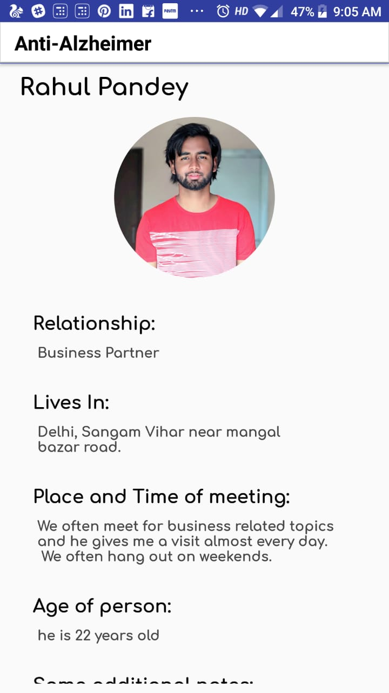
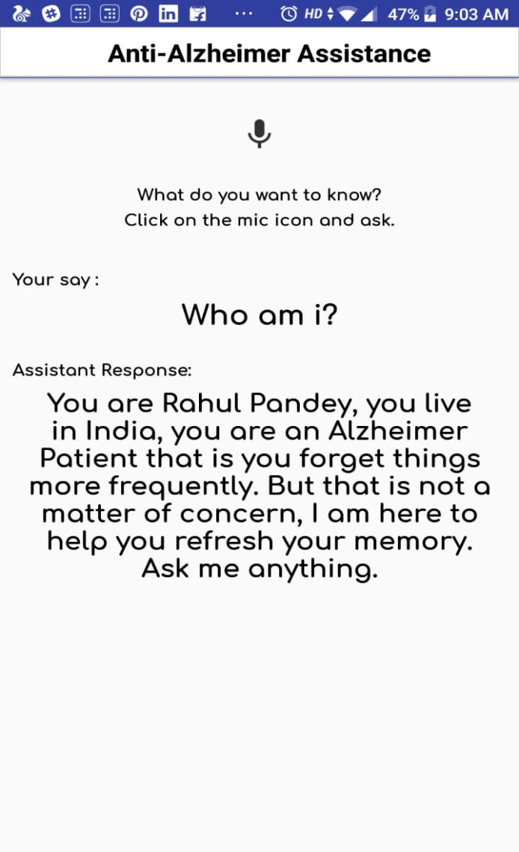
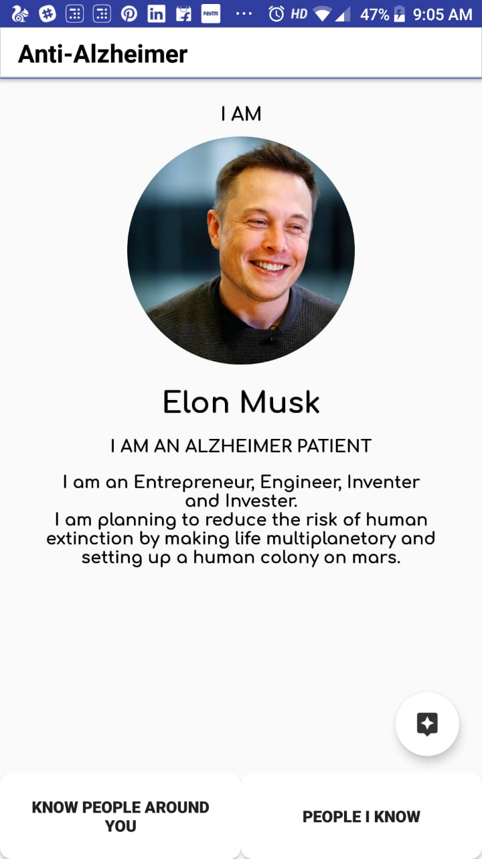
What we have covered?

Slide 7
What’s our team?
“Teamwork begins by building trust. And the only way to do that is to overcome our need for invulnerability.”
Nitin Gupta (BackEnd)
Rahul Pandey (Android and ML)
Tushar Gupta (Android and AI)
Pranav Jain (ML)

